Slide 1
Aviatrix ACE Associate
Introduction
ACE Solutions Architecture Team

Slide 2

Shahzad Ali
Shahzad Ali is Vice President of Solutions Architecture at Aviatrix. He is an expert on private and public cloud networking and coinvented the Multicloud Network Architecture (MCNA).
He is also a co-founder and content lead for the Aviatrix Certified Engineer (ACE) Program, the industry’s first multicloud networking certification.
Shahzad previously led the Solutions Architecture team at VMware, where his team played a crucial role in growing VMware’s NSX business.
Before that, he spent over a decade in technical and leadership roles at Cisco Systems.
https://linkedin.com/in/shahzadNET/
https://youtube.com/netJoints

Slide 3
ACE Program and ACE Associate Introduction
Industry’s First
Industry’s first multi-cloud networking education & certification.
ACE-Associate
Cloud networking introduction. Usually, it is a 4 to 5 hours.
Networking Focused
High Level
Develop advanced networking security, and operational competencies in the public cloud.
Covering topics at a high level
Fast Paced
Learning Tracks
Focused with a lot of concepts – can be overwhelming!
https://community.aviatrix.com
Associate, Professional, Design, Specialties (Security, Backbone, Automation, etc.)
Notes:
© Copyright PresentationGo.com – The free PowerPoint template library

Slide 4
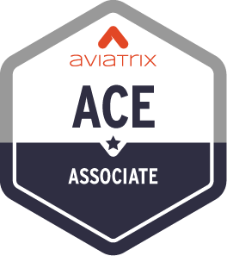
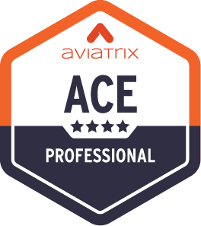

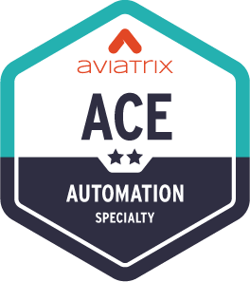
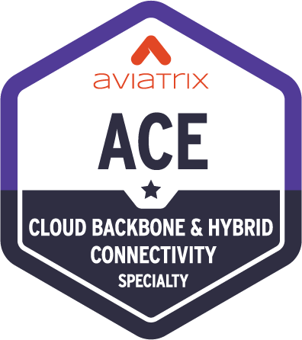
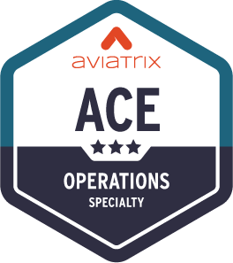
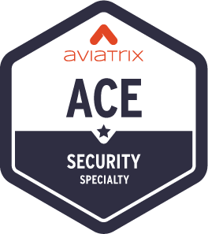
ACE Multicloud Networking Learning Paths
https://aviatrix.com/ace/
Standard Learning Path
4 Hours
Learn CSP networking basics and review Aviatrix features
3 Days
Deploy proven design patterns for a multicloud network architecture
Weeks
Design a highly available, scalable, and secure multicloud architecture
Optional Specialty Trainings
4 Hours
Use IaC tools to build, enhance, and secure infrastructure
4 Hours
Use the Aviatrix backbone to build hybrid connections
16 Hours
Troubleshoot real-world Day 2 cloud issues​
4 Hours
How to secure the network deployed inside the cloud

Slide 5
ACE-Associate Prerequisite & How to get Certified
Prerequisite:
Basic networking understanding (Router, IP Address, Subnet, TCP/IP, etc.)
How to get Certified:
Create Aviatrix ACE Academy Account: https://ace.aviatrix.com/
Complete the LAB assignments
https://docs.aviatrixlab.com/flightschool/docs/home.html
Total five labs. Complete 3 Labs. 2 bonus.
An automated script will evaluate the completion of all labs.
PODs will be torn down as soon as the training has been completed.
Complete the Survey.

Slide 6
Outcome
Learners will be able to describe the shift from on-premises to cloud networking and understand why that shift is relevant today
Learners will be able to recognize the basic native networking capabilities of the primary cloud service providers and understand when to best leverage each one in their ecosystem
Learners will be able to recognize the native constraints in visibility, security, and control
Learners will be able to define how the shift to the cloud has created new possibilities and risks for security
Learners will be able to identify alternative solutions to enhance visibility and global monitoring capabilities, and learn how to reduce cloud costs when it comes to cloud networking

Slide 7
Aviatrix Certified Engineer Associate - Agenda
20%
15%
15%
10%
10%
30%
AWS Networking 101
Azure Networking 101
GCP Networking 101
OCI Networking 101
Multicloud Network Architecture
Aviatrix Platform Overview
AZ, Regions, VPC, Route Tables, IGW, VGW, AWS-TGW, Direct Connect
AZ, Regions, VPC, Route Table, VNG, vWAN, Express Route
AZ, Regions, Global VPC, Route Tables, Google Cloud Interconnect
Features, Functionalities, Comprehensiveness
Layered Architecture, Consistent across clouds, repeatable, simplify designs
Features, Functionalities, Comprehensiveness
LAB PODs For Attendees
Notes:
© Copyright PresentationGo.com – The free PowerPoint template library

Slide 8
About Aviatrix

Slide 9
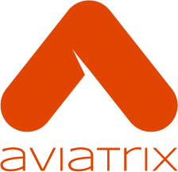



Simplify
Operations
We are the Cloud Networking Experts
Improve
Security
One cloud networking platform creates
the visibility, security and control
your business needs to adapt
with ease and move ahead at speed.
Reduce
Costs

Slide 10
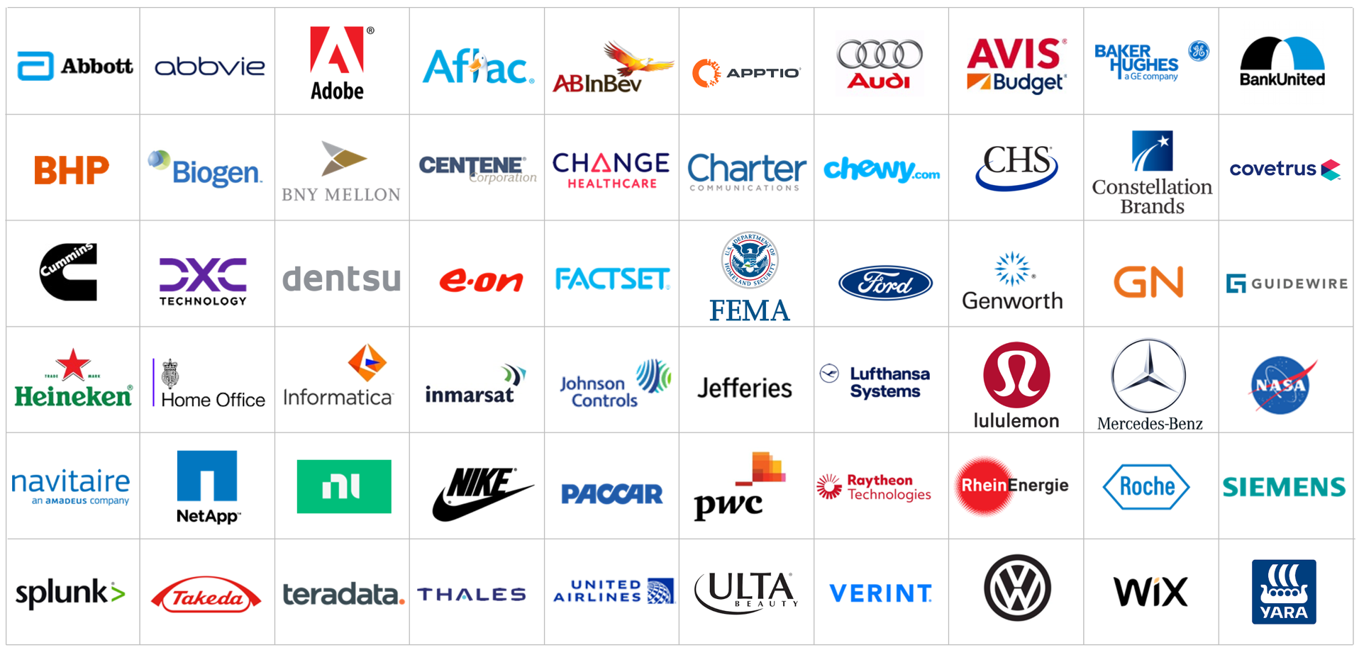
Enterprises Choose Cloud Networking Experts
Abbott Laboratories
AbbVie
Advance Auto Parts
Aflac
Assurant
Avis Budget Group
BT Group
Centene
CenturyLink
CHS
Constellation Brands
Dell
Discover Financial Services
DISH
DXC Technology
E.ON
First American Financial
Genworth
Heineken N.V.
Jefferies Group
Johnson Controls
Masco
National Oilwell Varco
NCR
NetApp
Netflix
Nike
PACCAR
Pioneer Natural Resources
Polaris
Reliance Steel and Aluminum Co
Siemens AG
The Walt Disney Company
United Airlines
Volvo Group

Slide 11
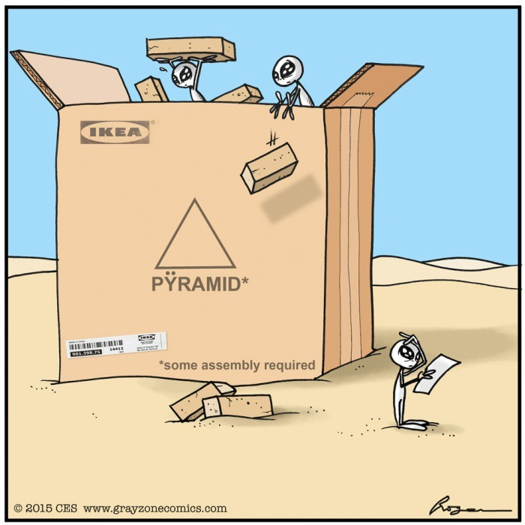

Why Not Use CSP Native Networking?
Build
Operate
Cloud provider is Go-Build mentality
Reference architectures doesn’t fit customers expectations
Disconnected Day 2 Operations
Lack of visibility and troubleshooting
Cost and Skillgap
Unknown and unpredictable cost
Missing operational data
Lack of common architecture in multiple clouds and minimal features when extending to on-premises
Heavy data processing charges, including Egress
Expert level skillset needed

Slide 12
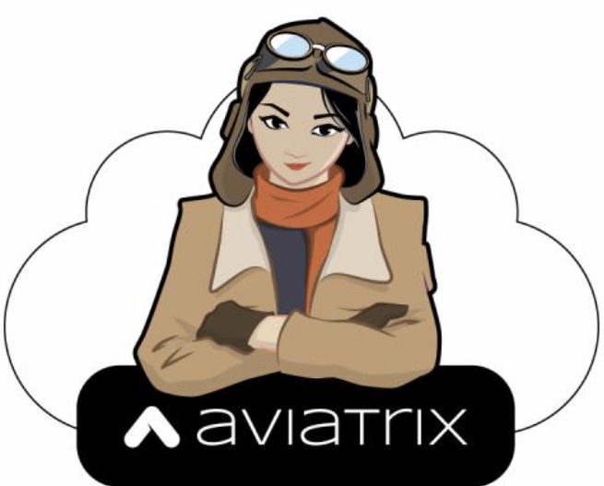
Aviatrix Solving Challenges for Enterprises in Public Cloud
Build
Operate
Cloud provider is Go-Build mentality
Reference architectures doesn’t fit customers expectations
Disconnected Day 2 Operations
Lack of visibility and troubleshooting
Cost and Skillgap
Unknown and unpredictable cost
Missing operational data
Lack of common architecture in multiple clouds and minimal features when extending to on-premises
Heavy data processing charges, including Egress
Expert level skillset needed
Aviatrix helps enterprises build – Fast and Right – Greenfield or Brownfield
Simple and familiar tools and operationalizing best practices in Public Cloud
Day 2 Ops ready visibility and tooling
Provides Multicloud Networking Software (MCNS) reference Architecture (MCNA)
Zero data processing charges
Simple design, deploy and run

Slide 13
Aviatrix Cloud Networking Platform
Software Components

Slide 14

Aviatrix Secure Cloud Networking
Own Your Cloud Network
Aviatrix
Controller
Operates on your cloud EC2/VM.
The Brain. Download from CSP Marketplaces.
Never in the data plane.
Control Plan
Operates on your cloud EC2/VM
Advanced day2 ops and enterprise-grade visualization.
Never in the data plane.
Aviatrix
CoPilot
Management Plane
Aviatrix
SMART Gateways
Operates on your cloud EC2/VM.
Advanced networking, security, and policy enforcement.
Data Plane
SMART: Secure, Multicloud-Aware, Application-Aware, Resilient, and Telemetry Provider

Slide 15






Embedding Intelligence in the Aviatrix Data Plane (SMART GWs)
Intelligent Routing
Dynamic Traffic Engineering
Distributed Cloud Firewalling
L4/L7, Zero-Trust Policy Approach
Telemetry
Network, Security, and Cost
Load Balancing
Intelligent Load Balancing, Bi-Directional Hashing
Additional Security
IDS/IPS, URL Filtering, Vulnerability Scanning, Threat Prevention, Anomaly Detection, Geo-Fencing, etc.
Additional Tools
Auto-scaling, Packet Capture, Ping Trace-Route
Routing
Aviatrix Intelligent Gateway
Telemetry
L4/L7 Firewalling
Load
Balancing
Additional
Security
Additional
Tools
SMART: Secure, Multicloud-Aware, Application-Aware, Resilient, and Telemetry Provider

Slide 16
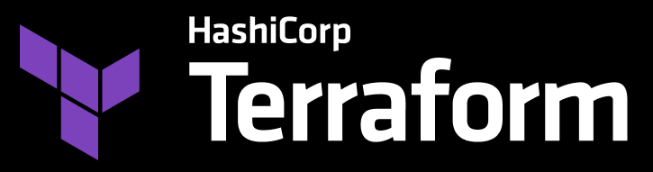

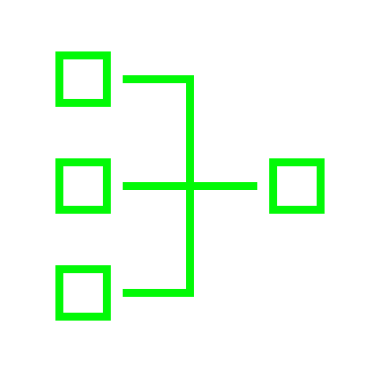




Aviatrix Secure Cloud Networking is a Programmable Distributed System
Aviatrix
CoPilot UI
Aviatrix
Control
Plane
VPC
VPC
VNET
VNET
VNET
VNC
VNC
Native Services
Native Services
Native Services
Data
Center
Equinix
Adv Networking & Telemetry
Embedded Security
Consistency Across Environments
Cloud Operating Model
Proven at Scale
Manufacturing
Retail / Branch

Slide 17
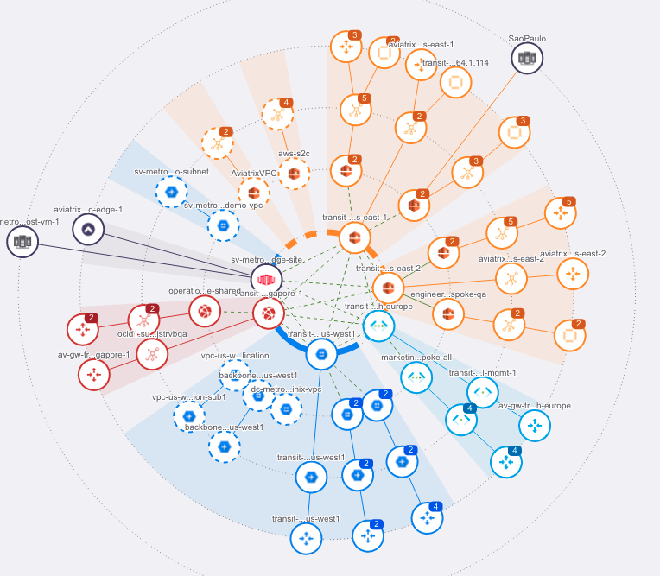
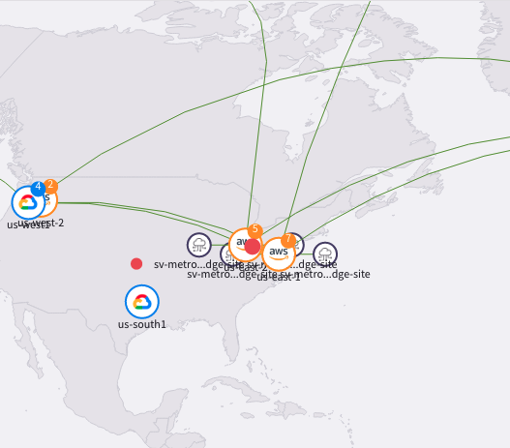
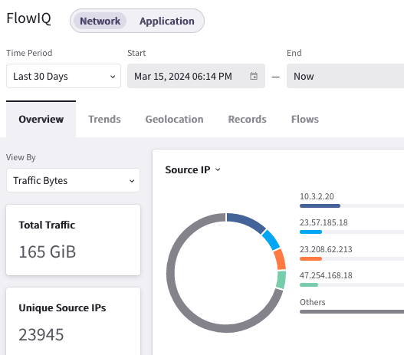
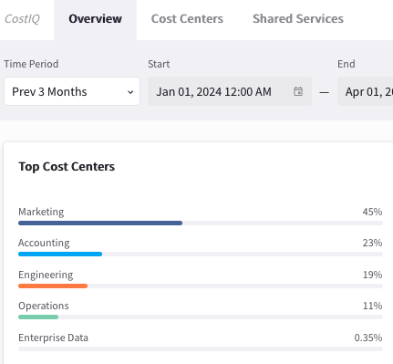













Aviatrix
CoPilot
Aviatrix
Controller
Global Architecture Providing Unified Security, Visibility and Control
VPC
VPC
VPC
VPC
VPC
VPC
VPC
VPC
VPC/ VNET
VPC/ VNET
Region 1
Region 2
DX
Dev/QA/IT
BRANCHES
DCI / MPLS / Equinix / Colo
ENTERPRISE PAIN POINTS
SECURE CLOUD NETWORKING
EMBEDDED SECURITY
SECURE CLOUDE DGE
High-Performance Encryption
Repeatable Design
Enterprise Operational Visibility
Consistent and Granular Security
NAT-GW Cost Savings
Anomaly and Threat Prevention
Secure Egress and Distributed Cloud Firewall (L4/L7)
Hybrid Connectivity to On-Prem Overlapping IP Support
High-Performance IPSec Encryption to DC/COLO/Equinix

Slide 18
Next: Introduction to Public Cloud Networking

Slide 19
Aviatrix Certified Engineer Associate
Topics | Approx. Duration | Start time CET
About ACE Associate and Certification Logisitics | 0:15 | 9:00 AM
About Aviatrix | 0:10 | 9:15 AM
Public Cloud Networking | 0:10 | 9:25 AM
AWS Networking 101 | 0:30 | 9:35 AM
Break | 0:15 | 10:05 AM
Azure Networking 101 | 0:25 | 10:20 AM
GCP Networking 101 | 0:20 | 10:45 AM
OCI Networking 101 | 0:15 | 11:05 AM
MultiCloud Network Architecture (MCNA) | 0:15 | 11:20 AM
Break | 0:15 | 11:35 AM
Aviatrix Platform Overview - Part 1 | 0:45 | 11:50 PM
Lunch Break | 1:00 | 12:35 PM
Aviatrix Platform Overview - Part 2 | 0:45 | 1:35 PM
Operations | 0:30 | 2:20 PM
Break | 0:10 | 2:50 PM
UI Walkthrough [Tour] | 0:45 | 3:00 PM
Survey | 0:05 | 3:45 PM
Break | 0:10 | 3:50 PM
Labs | 1:00 | 4:00 PM
End | 8:00 | 5:00 PM
Meet the Presenters

Slide 20
Expectations from Today’s Session
Overview
High-level discussion on public cloud challenges Aviatrix addresses
No deployment or configuration-related discussion –> (ACE PRO training…)
Public Cloud Networking 101
Basics of networking in AWS, Azure, GCP and OCI
Bring all on the same page for public cloud networking 101
Fast Paced & Focused
Aviatrix terminology
Features at-a-glance
How to get Certified
Attend the entire course + complete the final lab + complete the survey
Slides and Recordings are not distributed
The self-paced course at https://ace.aviatrix.com/ace-associate (use coupon code acemulticloud)
Aviatrix Community page: https://community.aviatrix.com
Aviatrix YouTube page: https://www.youtube.com/c/AviatrixSystems

Slide 21
About Aviatrix
What Do We Do?
Secure Cloud Networking
Why Does It Matter?
Optimize business-critical application availability, performance, security, and cost
Why Are We Better?
Our platform delivers cloud simplicity and agility with enterprise-grade visibility and control
What’s Our Market Category?
Multicloud Networking Software (MCNS)

Slide 22







Secure Cloud Networking Platform Attributes
CoPilot
Cloud Fabric
Multicloud Observability Dashboard
INTELLIGENT
TELEMETRY
PROGRAMMABLE INTENT
Multicloud
Distributed
Network
Data Plane
DISTRIBUTED
CONTROL
OPERATIONAL VISIBILITY

Slide 23








Aviatrix Secure Cloud Networking Platform
Own Your Cloud Network
CoPilot
Controller
Embedded Observability
Control Plane
Reports Everything
Orchestration Plane
Security Actions
Automation Plane
Secure Everything
Traffic Control Actions
Cloud Fabric
Operational Visibility
Embedded Telemetry
See Everything
Distributed Control
Control Everything
Cloud Networking Abstraction
Bring Your Own NGFW
Third Party Controls
Service Insertion and Chaining

